Slide 1

2022 General Fund & Levy
Dominique Hill- Credit River Treasurer
November 15th, 2021
City of Credit River creditriver-mn.gov

Slide 2

2022 Budget Schedule – next steps
11/15
Council Levy/Budget Workshop
12/6
TNT Information
Council Levy Resolution
12/28
Final Levy to Scott County
12/20
2nd Council meeting
CITY OF CREDIT RIVER MINNESOTA

Slide 3
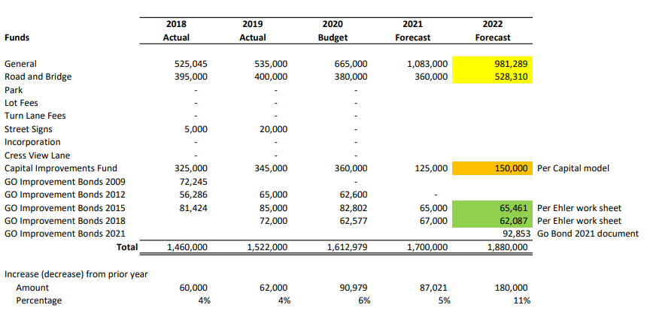
Prelim Levy
CITY OF CREDIT RIVER MINNESOTA

Slide 4
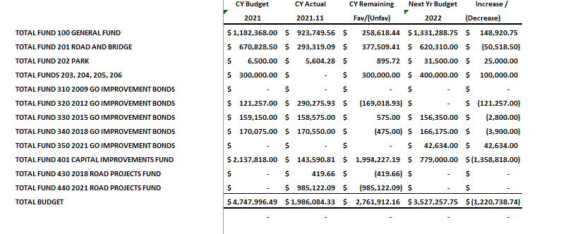
General Fund Overview
CITY OF CREDIT RIVER MINNESOTA

Slide 5
Budget Change Items
Fire Contract - Fire Station +107,000
Election – 2 locations added cost: pads, rent est. +10,000
Grader +70,000 purchase , insurance ?
CIP Road Projects +40,000
Website +25,000
MSA proposed 175K
Land Park? Government Center?
CH 21/Natchez Ave Signal +1,200
Park Project?
CITY OF CREDIT RIVER MINNESOTA

Slide 6
Council Action
Approve adding items in budget
MSA proposed 175K
ARPA funds
Levy Bond Review prepayment Higher by 150,000
Finalize Levy Dec 6 very latest Dec 20
TNT Presentation
CITY OF CREDIT RIVER MINNESOTA

Slide 7
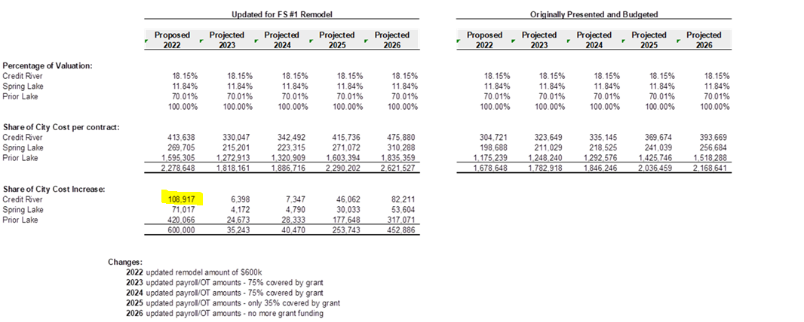
Fire budget increase
CITY OF CREDIT RIVER MINNESOTA

